Slide 1





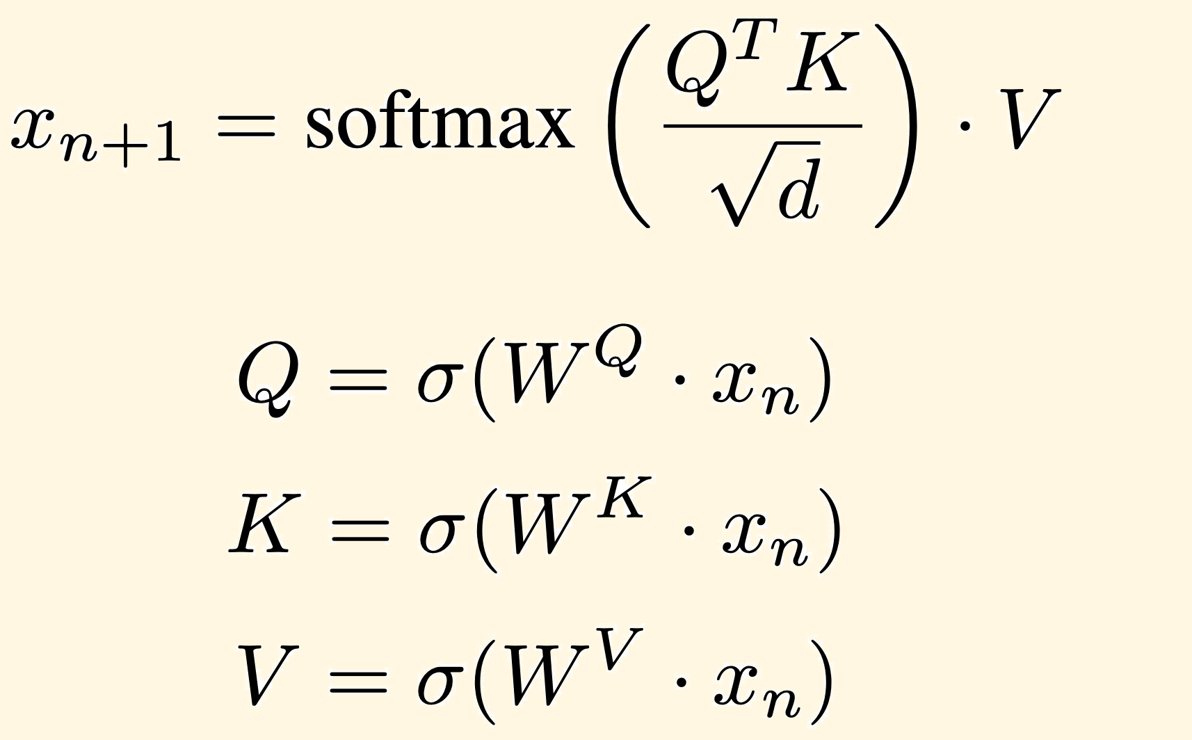



BEYOND OUR
CONTRADICTIONS
Feature augmentation in large language models for textual entailment detection.
Jérémie Dentan – Ecole Polytechnique, MVA (jeremie.dentan@live.com)
Alicia Rakotonirainy – CentraleSupélec (alicia.rakotonirainy@gmail.com)
TEXTUAL ENTAILMENT
A huge part of the meaning of a text is not expressed explicitly, but
added to the text by readers through inference.
Given 2 excerpts of texts, can the meaning of one be inferred from the other?
In Moria you will find the remains of a huge Roman aqueduct.
There is something special to see in the village of Moria.
LARGE LANGUAGE MODELS AND FEATURE AUGMENTATION
Large Language Models :
Large data scrapped on the internet
+
Several pre-trained attention layers + hundreds of millions of parameters
Sentence 1
+
Sentence 2
Attention layers :
Feature augmentation :
sentence 1
cosine similarity
sentence 2
gap
sentence 1
Gap
Cosine similarity between :
- The gap
- The mean gap of each class
sentence 2
RESULTS
DISCUSSION
with
Accuracy with BERT only: 0.60
The classification accuracy remains surprisingly low, even after using different embedding models. However, we have achieved to show that adding our new features significantly increases performance, with negligible additional computation time.
Sentences pairs
BERT
XGBoost classifier
distiluse
embeddings
cosine sim
Output
gap
paraph-MiniLM
embeddings
cosine sim
gap
paraph-mpnet
embeddings
cosine sim
gap
BERT training time: 90min
New features computation time + XGBoost: 2.3min
Whole model accuracy : 0.63
+3% accuracy!

